Slide 1

G2M Case Study
Virtual Internship
20-Sep-2022

Slide 2
Summary
Objective:
XYZ is a private firm in US. Due to remarkable growth in the Cab Industry in last few years and multiple key players in the market, it is planning for an investment in Cab industry and as per their Go-to-Market(G2M) strategy they want to understand the market before taking final decision.
Project delivery:
You have been provided with multiple data sets that contains information on 2 cab companies. Each file (data set) provided represents different aspects of the customer profile. XYZ is interested in using your actionable insights to help them identify the right company to make their investment.
The outcome of your delivery will be a presentation to XYZ’s Executive team. This presentation will be judged based on the visuals provided, the quality of your analysis and the value of your recommendations and insights.

Slide 3
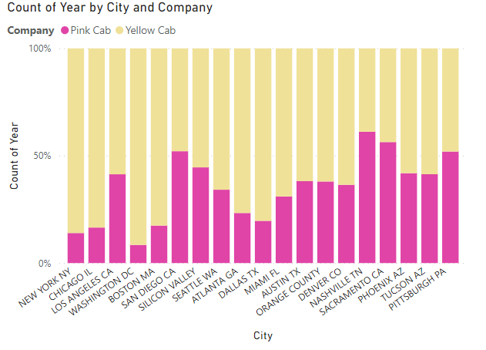
Cabs used by each City

Slide 4
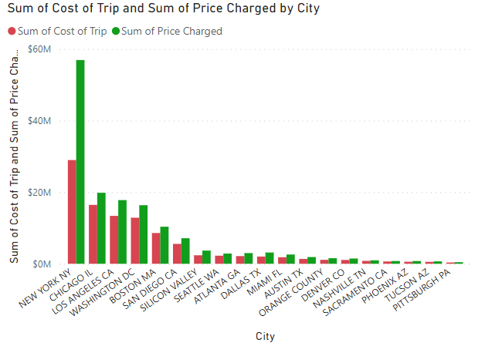
Profits earned from each City

Slide 5
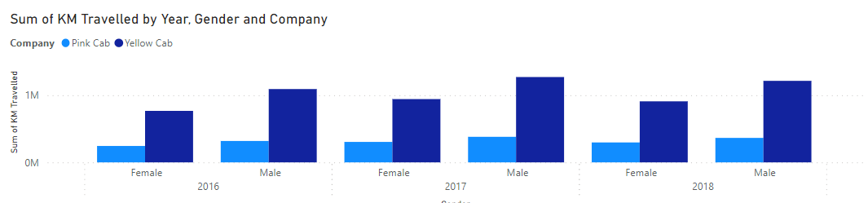
Cabs used by Male and Female every Year

Slide 6
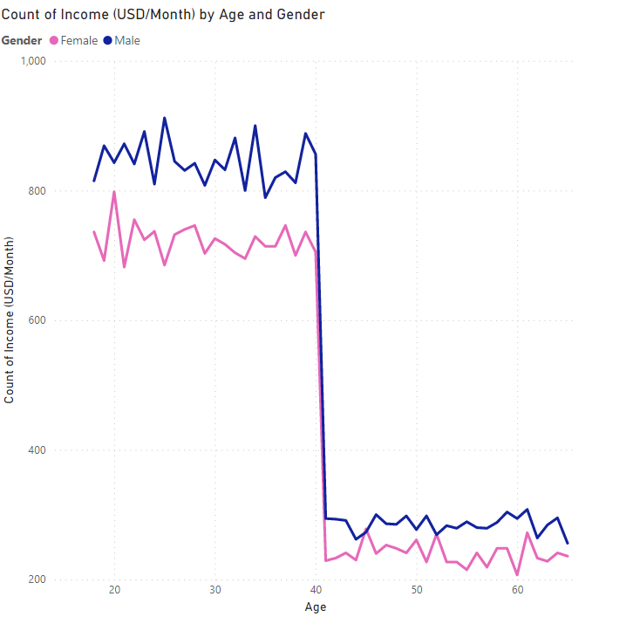
Income earned according to their age and Gender

Slide 7
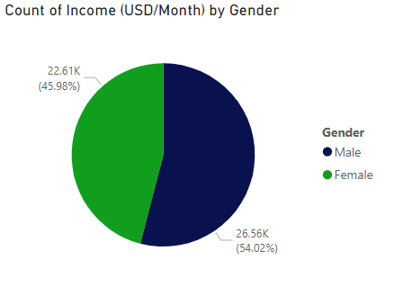
Income comparison between Male and Female

Slide 8
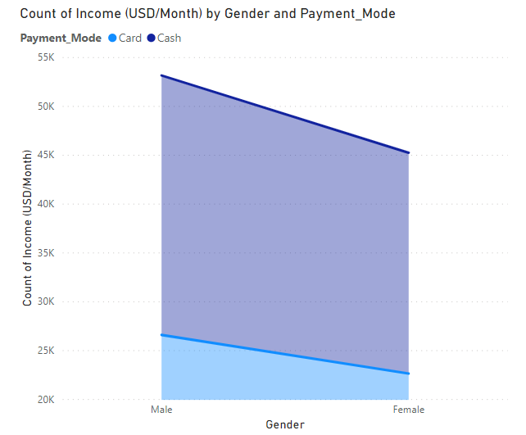
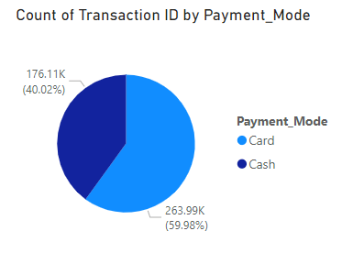
Payment mode used by Male and Female

Slide 9

Thank You

